Slide 1
Intro
Small project that demonstrates the steps involved in almost any data analytics/science project.

Slide 2
Background & Goals
Background: LENDus.com is a lending company that partners with banks to provide consumer loans.
Goals:
Automate the process of determining creditworthiness.
Divide past applicants into groups to send the applicants customized email offers.

Slide 3
Process Flow
Collect
Clean
Explore
Model & Interpret

Slide 4

Collect data
Recorded online Loan applications.
Stored in a tabular format(columns X rows).
Data obtained is owned & managed by from LENDus.com database. no 3rd party was needed, so the data was internal.

Slide 5
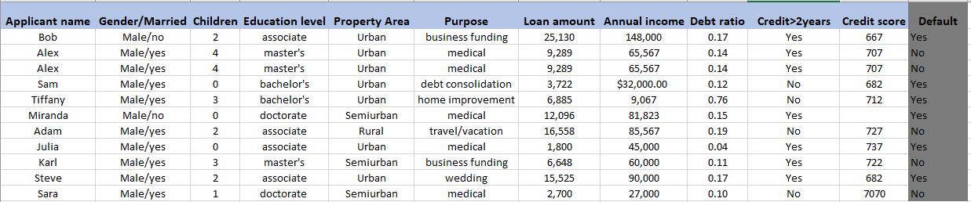
Loan Approval Data (12 columns X 3000 rows)

Slide 6

Clean data
Analysis is as good as quality of data
Irrelevant columns
Empty cells
Wrong format
Wrong data points
Outliers(extreme values)
Duplicate rows
-do mind with technique, tools will be used to detected and fix those issues
5 issues total(dup, divide, rng format, null value, outlier/wrong datapoint)

Slide 7

Explore data (visual & non-visual)
Type of each variable
Characteristics of variables
Shape/pattern of variables
Trends
Relationship between the variables

Slide 8
Variable data type
Children(0,1,4 ,…) : Numerical
Education level(associate, master’s, …): Categorical
Property Area(Urban, Semiurban, …): Categorical
Annual income(23,000, 9000, …): Numerical

Slide 9
Variable shape and characteristics

Slide 10
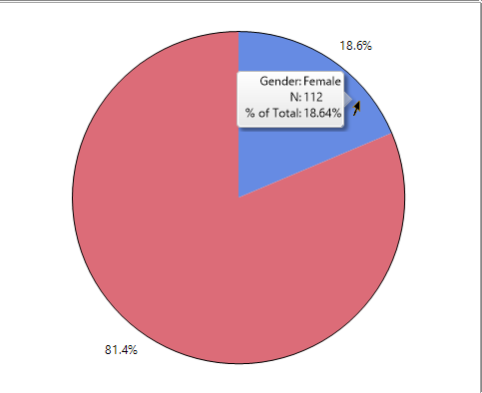

Slide 11
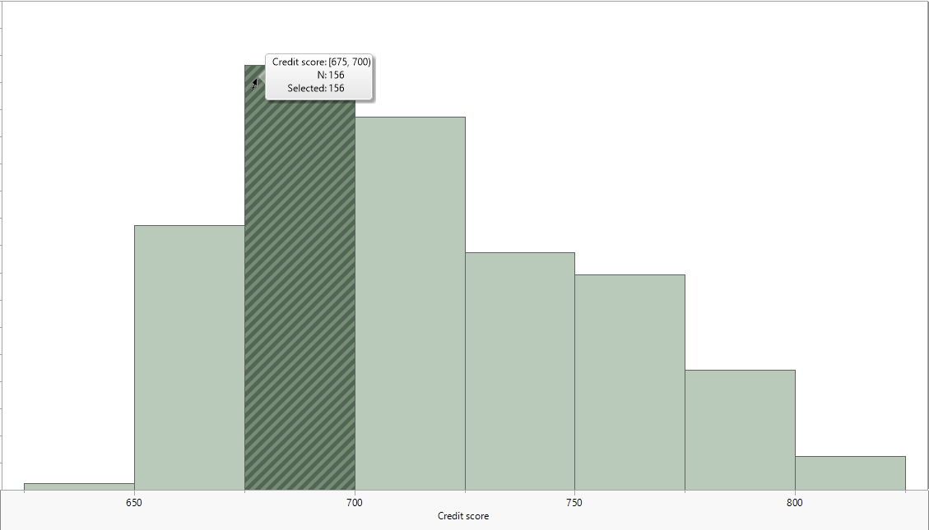

Slide 12
Credit Score 0.8 -0.7 | Descriptive Stats
0.8 | Average | 715
-0.7 | Std Dev | 39
 | Min | 627
 | Max | 822

Slide 13
Relationship between variables
Variables | Correlation(-1,1) | Shape
Annual income, Credit score | 0.8 | ↑↑
Children, Loan amount | -0.7 | ↑↓

Slide 14

Model & Interpret
Classify new applicants(default/not default)
Put past applicants into groups

Slide 15
To illustrate how this model work, let’s consider these 2 case scenarios.
Data submitted online through form, model will receive these values(characteristics) as input, produce one of two values as output(def/not def)
How does the model know?
Before deployment, model has gone through a statistical training process using applications(along with their outcome) that have been recorded in the past
It has Learned to tie certain characteristics with a certain outcome
it’s worth noting that Model predictions are not 100% accurate. It’s up to a human to make the final decision

Slide 16
Hard for a human to detect these patters but easy on a computer given that it has more resources and it’s more efficient

Slide 17



Annual Income: $32,000
Loan amount: $120,000
Rejected
Default
Credit score: 690
Alex
Annual Income: $44,000
Approved
Loan amount: $90,000
Not Default
Credit score: 760
Jessica

Slide 18

Model Training

Slide 19
Forget the colored circles/ovals and express what each spot represent
Depending on the credit score & annual income info, Our model will place the observations into 3 clusters/groups
Group red, green and blue
Analyst will infer the characteristics of each group(Low AI, Low CS & low AI, high CS)
Prepare customized loan offers:
-> Low AI, Low CS: small loans with recommendations on how to improve CS)
low AI, high CS : larger loans

Slide 20
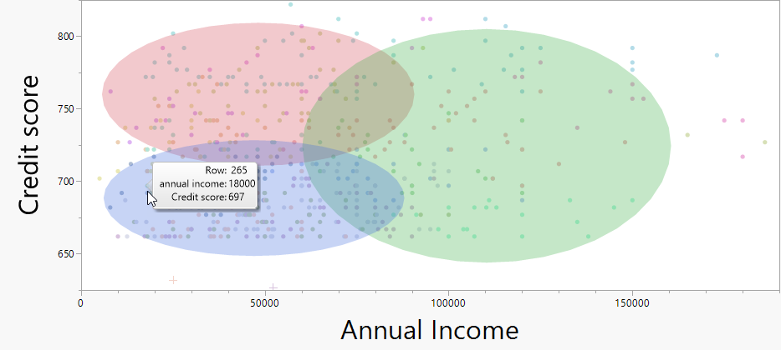
Grouping applicants

Slide 21
Collect:
data may not be readily available in our database
Data required might not exist in one place and needs to be collected from different places
Data might not be in table format
Clean:
- we handled a very small portion of the issues that can be present in our data, handling those may require sophisticated tools
Explore:
-many other statistical measures, charts can be used to further identify the characteristics of our data.
Model:
-target might be numerical(not categorical), trends or relationship between variables needs more sophisticated ML models to be detected and so on.

